Slide 1
Pandas:
Risk and Returns Over Time
Lesson 3.3

Slide 2
Review

Slide 3

Returns Over Time
Returns over time require investment close prices, i.e., stock data. Stock close prices can be acquired from Nasdaq.com.
Returns over time can be calculated using the pct_change() function.
Notes:
Image source: shutterstock_1172582506

Slide 4

How confident are you in taking financial risks?
Notes:
Image source: AdobeStock_210483605

Slide 5
Sorting

Slide 6
Sorting
Data is not always organized in the best way for analysis. Sometimes, data needs to be cleaned and sorted.

Slide 7

Sorting
The sort_values function in Pandas can be used to sort a DataFrame. Sorting data helps improve visual representation of data.
Data can be sorted in either ascending or descending order.
sort_values(ascending=True)
Consider dates: would you rather see dates sorted or randomly listed?

Slide 8
Activity: Out of Sorts
In this activity, you will extract data for a single ticker from NASDAQ and calculate daily returns for the year 2019. The data will then be sorted in descending order to identify the top 5 performing days for returns.
(Instructions sent via Slack.)
15 Minutes

Slide 10
Grouping

Slide 11
Grouping
A key component of data analysis is grouping data. Grouping allows for similar data to be aggregated or manipulated as groups.
Example aggregations that can be done on groups are adding, summing, determining min and max, etc.
Category | Sales
a | 1
a | 2
b | 10
b | 9
Category | Sales
a | 3
b | 19

Slide 12




Grouping
Behind the scenes, the Pandas groupby function does the following:
Splits the data into groups based on certain criteria.
Applies a function to each group independently.
Splitting Data Applying a Function Combining Results

Slide 13
Activity: Group Dynamics
In this activity, you will work with historical cryptocurrency data. You will load in cryptocurrency data, group data by each crypto, and then perform aggregations to analyze price trends. You will then plot the results.
(Instructions sent via Slack.)
15 Minutes

Slide 15
Multi-Indexing

Slide 16

Multi-indexing is the process of creating more than one index for a DataFrame.

Slide 17
Multi-Indexing
Sometimes, one index is not enough for performing data lookups; more than one index is needed. For example, it is common to use multi-indexing when working with dates. This allows data to be accessed by year, month, and/or day.
 | one |  |  | two
 | a | b | c | a | b | c
0 | -1.401530 | 0.626666 | -0.165782 | -0.361173 | -1.139887 | -0.027251
1 | 1.201998 | -0.665546 | -0.554207 | 0.644199 | 0.572868 | -1.552404
2 | -1.201190 | -1.428929 | 1.226697 | 0.162548 | 1.481702 | 0.721526
3 | -1.622470 | 0.541475 | -0.482980 | -1.970389 | 1.974586 | 0.165966

Slide 18
Activity: Indexing Fever
In this activity, you will use hierarchical indexes to gain access to historical stock data. You will leverage NASDAQ data to perform data segmentation for a single ticker across multiple months in a year.
(Instructions sent via Slack.)
15 Minutes

Slide 20

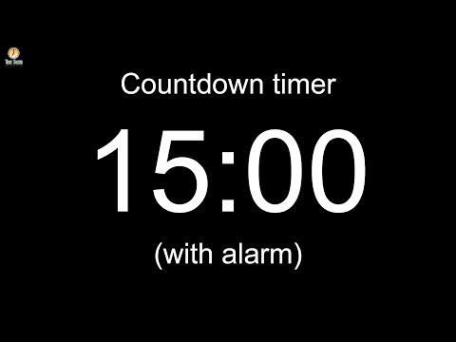
Notes:
Image source: AdobeStock_157033350

Slide 21
Concatenation

Slide 22
Concatenation is the process of joining one dataset with another.

Slide 23

Concatenation
Pandas has a concat function that can be used to combine DataFrames.
DataFrames can be concatenated so that the records from two DataFrames are combined.
DataFrames can be combined by column so that the columns from one DataFrame are placed adjacent to columns from another
DataFrame.
Notes:
Image source: AdobeStock_199941332

Slide 24
Activity: Mastering Concatenation
In this activity, you will combine multiple DataFrames using the concat function.
(Instructions sent via Slack.)
15 Minutes

Slide 26
Standard Deviation and Risk

Slide 27
Standard deviation measures how dispersed a set of values are from their average.

Slide 28
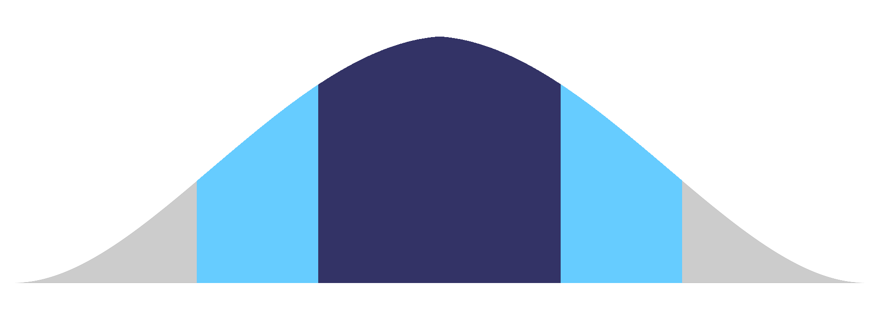
Standard Deviation
The std Pandas function is used to calculate standard deviation for a DataFrame. Standard deviation can be used to determine the risk associated with an investment. Standard deviation is also used to calculate how much returns have been distributed from the average.
3 Standard Deviations
3 Standard Deviations
2 Standard Deviations
1 Standard Deviation
1 Standard Deviation
2 Standard Deviations

Slide 29
The greater the standard deviation, the greater the risk and the potential for a greater payout.

Slide 30
Sharpe Ratios

Slide 31
Sharpe Ratios
Whereas standard deviation calculates how dispersed a set of values are, Sharpe ratios identify how much excess reward is associated with an investment after risk has been accounted for.
Sharpe ratios are calculated by dividing annualized
average returns by annualized standard deviation.
R
R
p
f
Sharpe Ratio =
O
p

Slide 32
Activity: Risky Business
It's time to put it all together. In this activity, you will prep data and use standard deviation and Sharpe ratios to analyze cryptocurrency portfolio performance.
(Instructions sent via Slack.)
15 Minutes

Slide 34

Congratulations!
You just leveled up and acquired the following skills:
Data consolidation
Data segmentation
Data profiling and quality
Investment and portfolio risk analysis
Notes:
Image source: shutterstock_1170546082

